Slide 1
Manager’s Report
February 10, 2010
Notes:
Welcome
Introductions

Slide 2
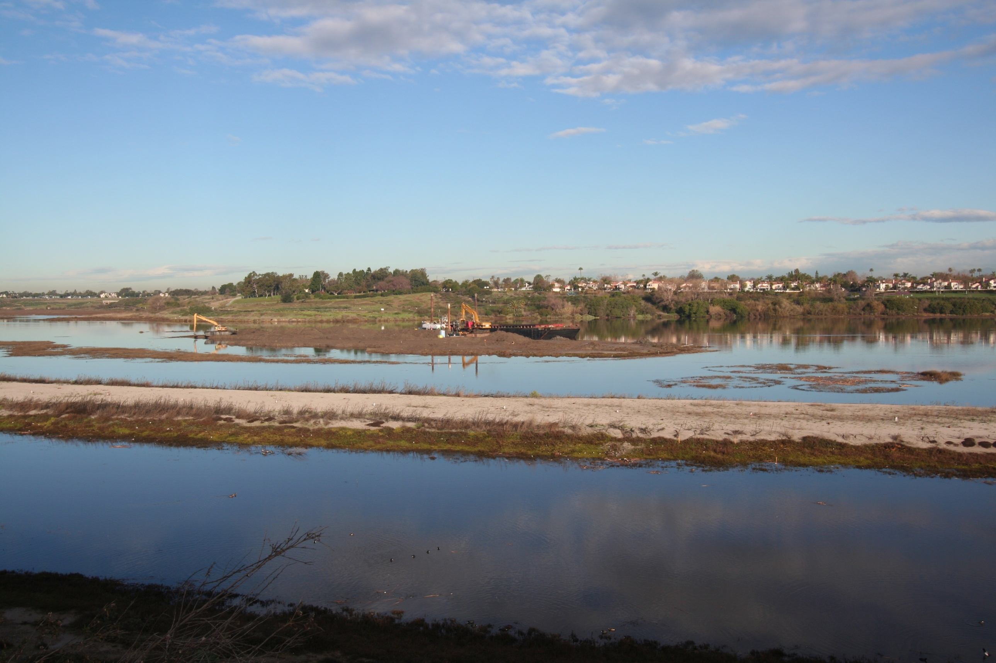
Dredging – Upper Newport Bay
Skimmer Island is being reduced in size to increase the capacity of the Unit I/III basin
Excavators are also busy dredging the basin
Skimmer Island
Hot Dog Island

Slide 3
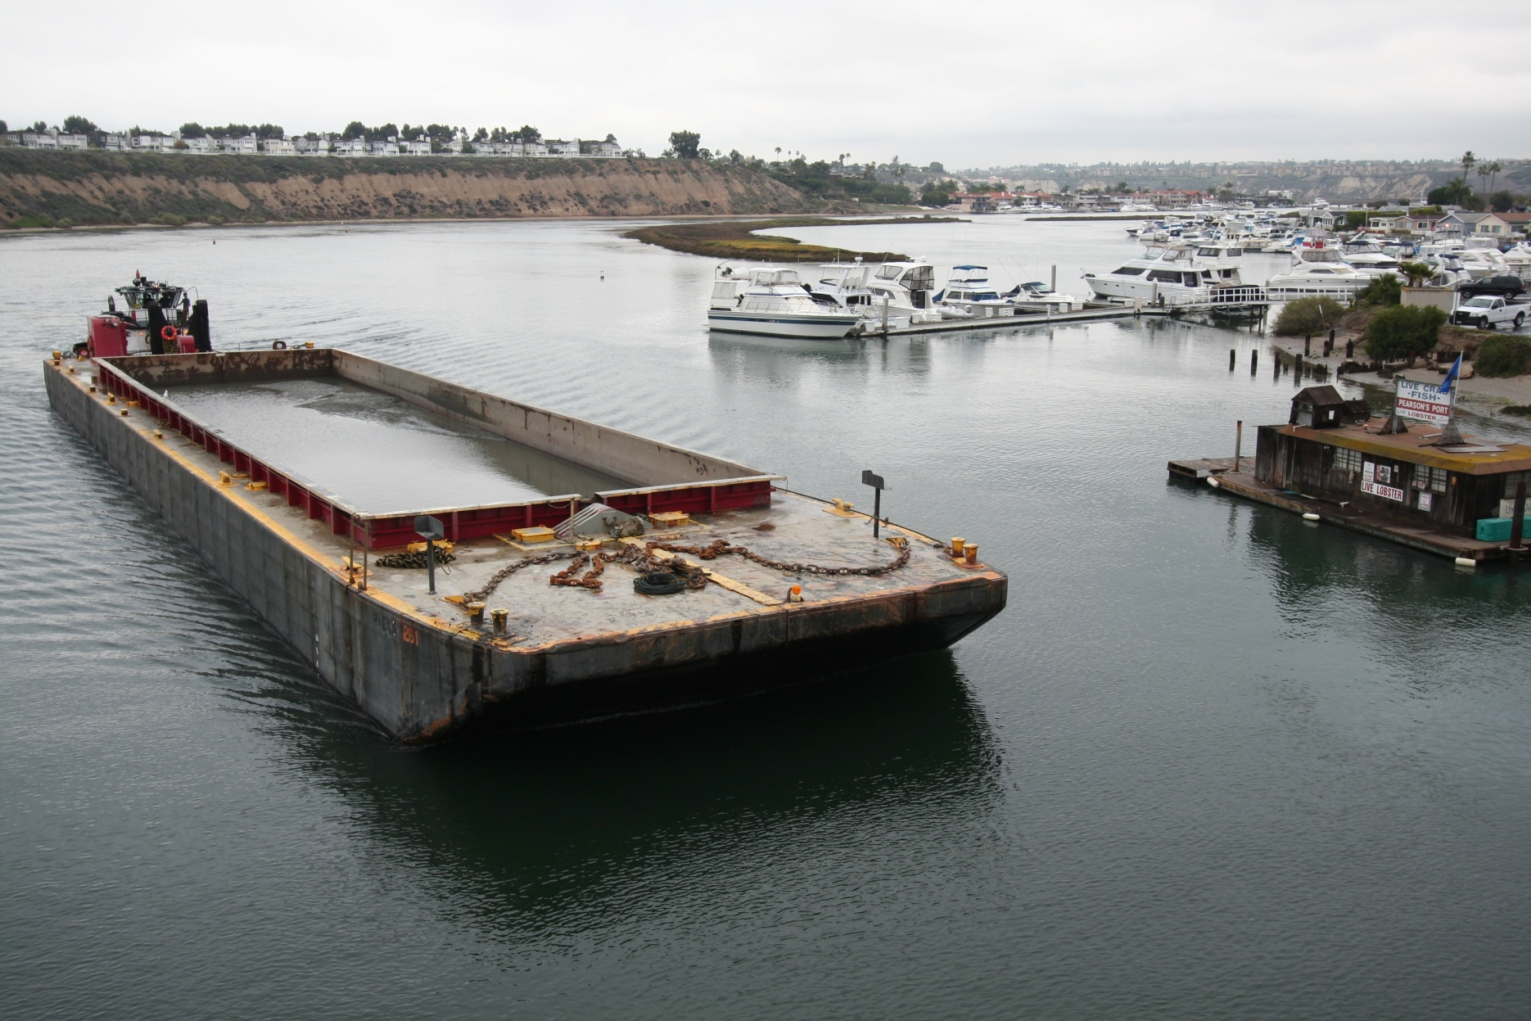
Dredging – Upper Newport Bay

Slide 4
Dredging – Lower Newport Bay & Rhine Channel
Funding
Appropriations requests have been submitted to Senators Feinstein and Boxer
Testing
The Corps has officially taken the lead with the project. We are busy working with the Corps and the DMMT to finalize our dredge plan for the clean material.
Rhine Channel
Anchor QEA is busy with the MND and EIR for this clean up effort that will occur with the Lower Bay project
Several questions remain about the City’s areas of responsibility
Funding is also an issue

Slide 5
Marina Park Progress
Draft re-circulated EIR has a 45-day public comment period (January 25 to March 10).
Tentatively scheduled for certification by City Council on May 11, 2010. Staff recommendation for project approval (Phase 1, 2, or 3).
Permits obtained for whichever phases Council approved.
Construction drawings complete after agency permit approvals.
Main Differences in EIR
Phased approach considered (sandy lot vs. turf lot vs. full project)
Wetlands determination

Slide 6
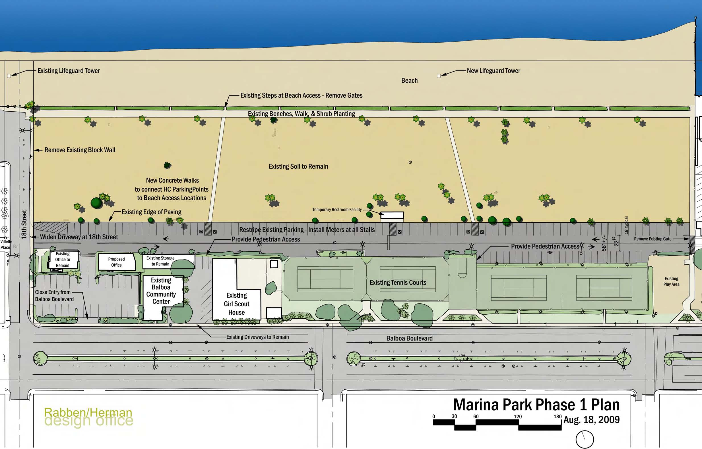
Marina Park – Phase I Plan

Slide 7
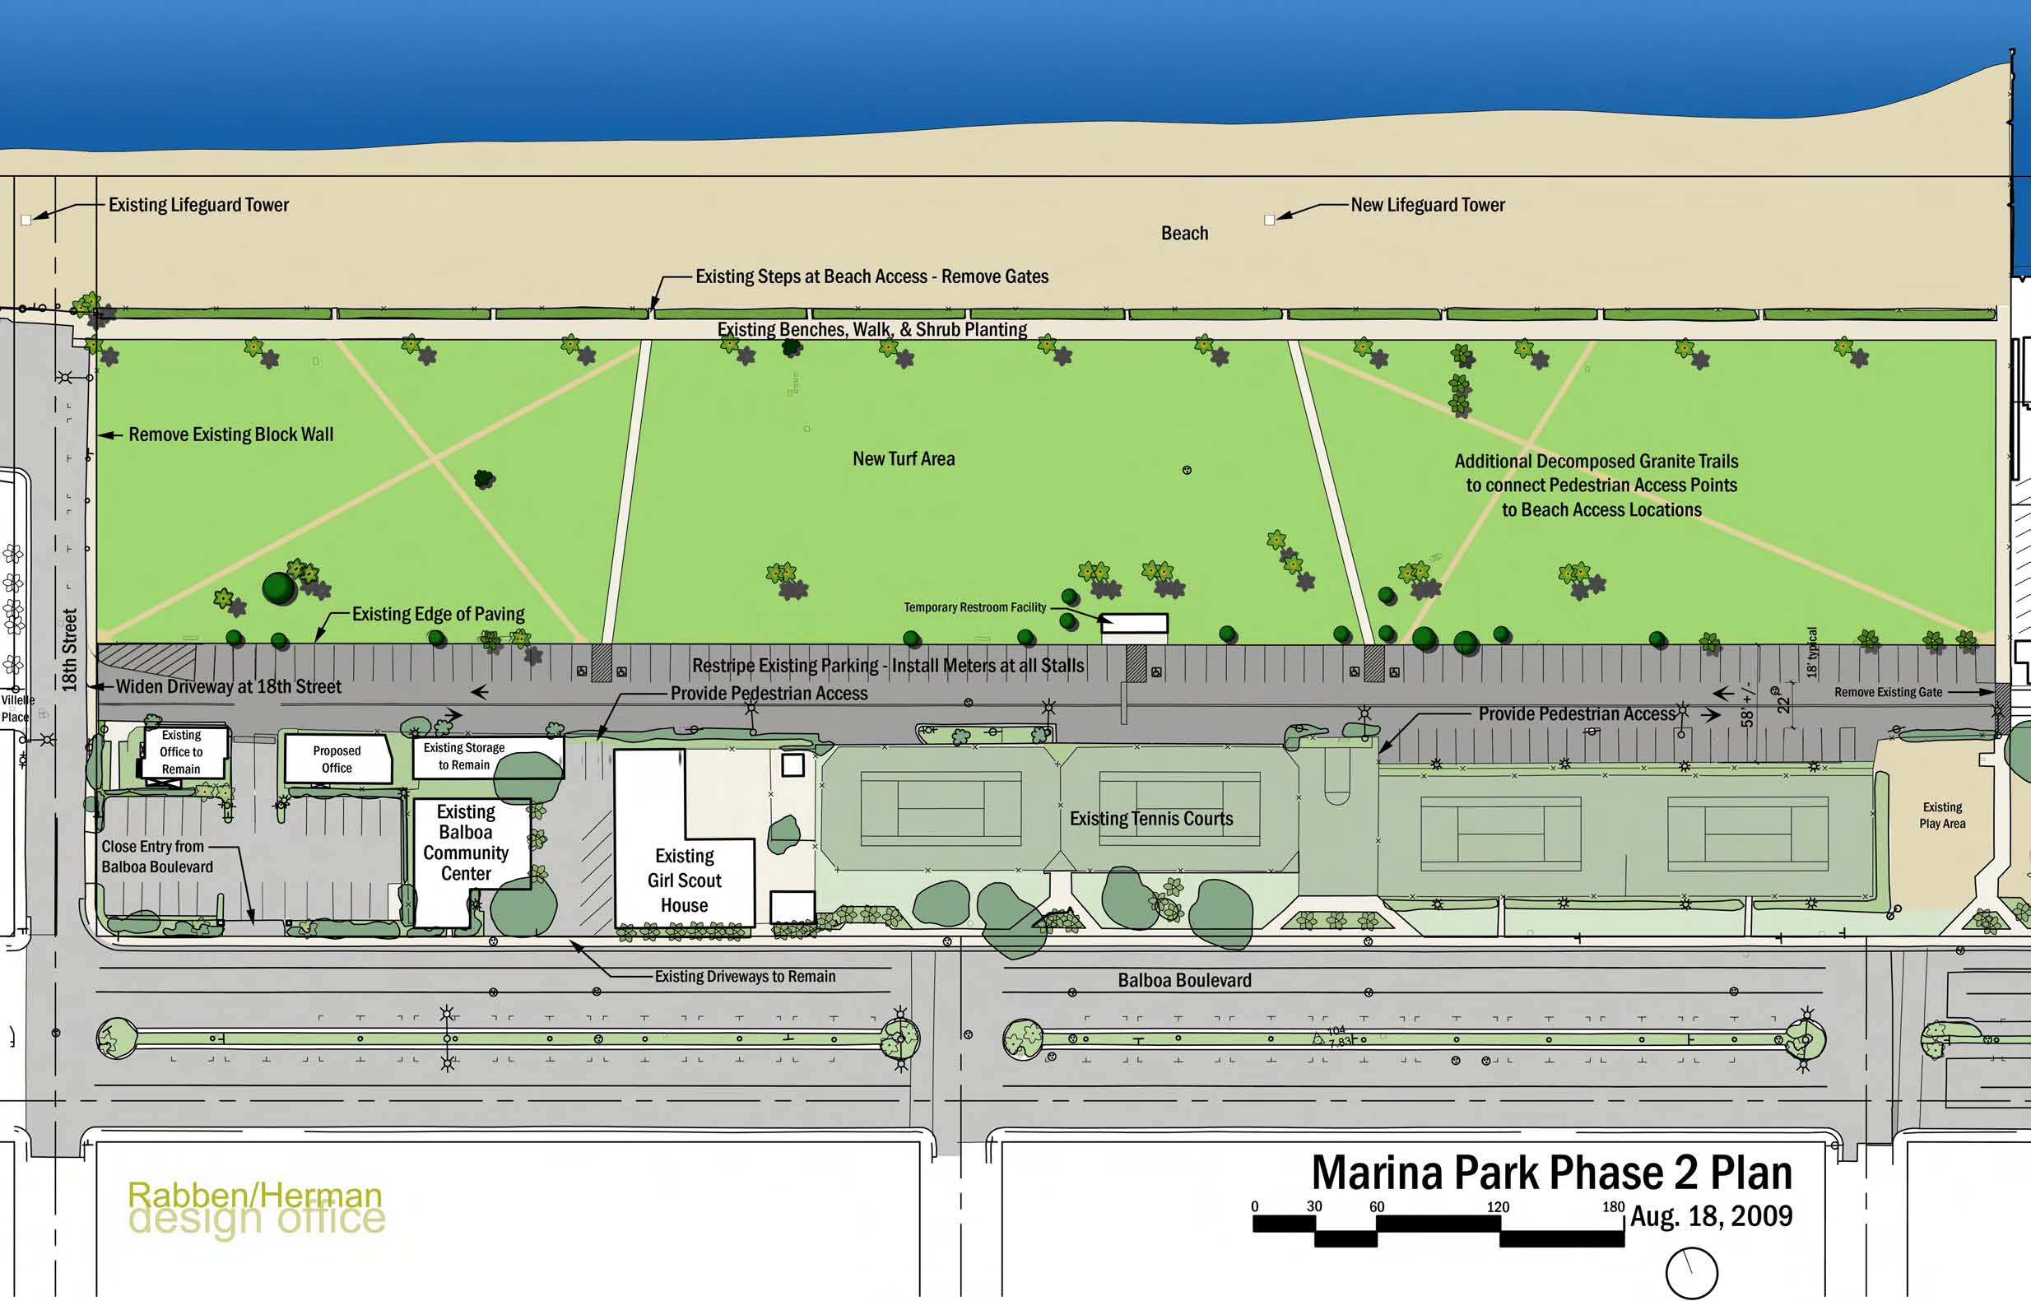
Marina Park – Phase II Plan

Slide 8
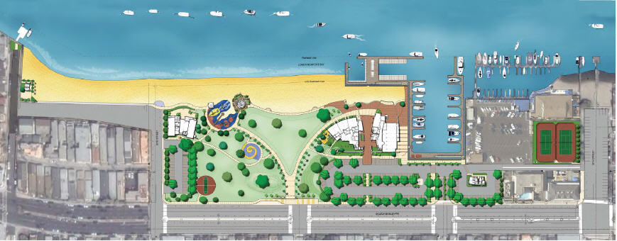
Marina Park – Phase III Plan

Slide 9
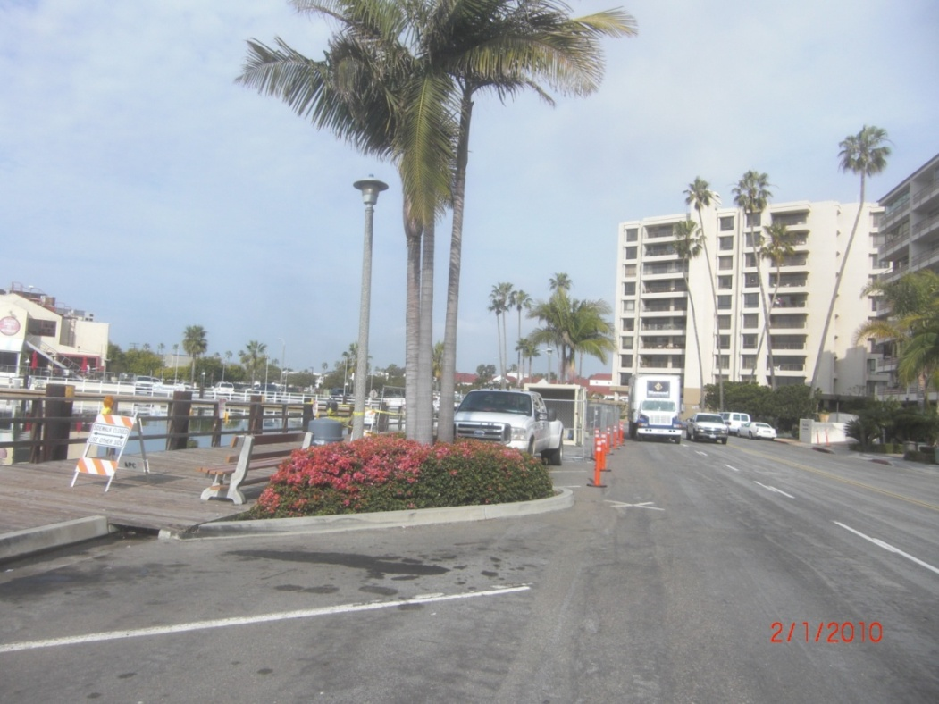
Rhine Wharf Repairs & Public Dock
Wharf repair
Start: February 1
Scheduled completion: March 22
Public Dock
Start: January 22
Scheduled completion:
May 18

Slide 10
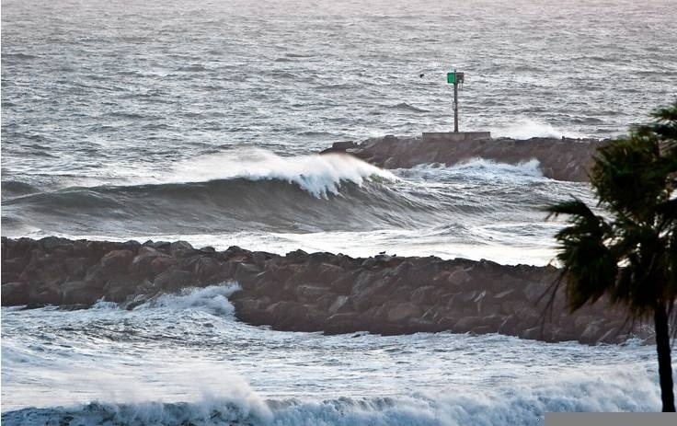
Other Issues
Entrance Channel Surf in January

Slide 11
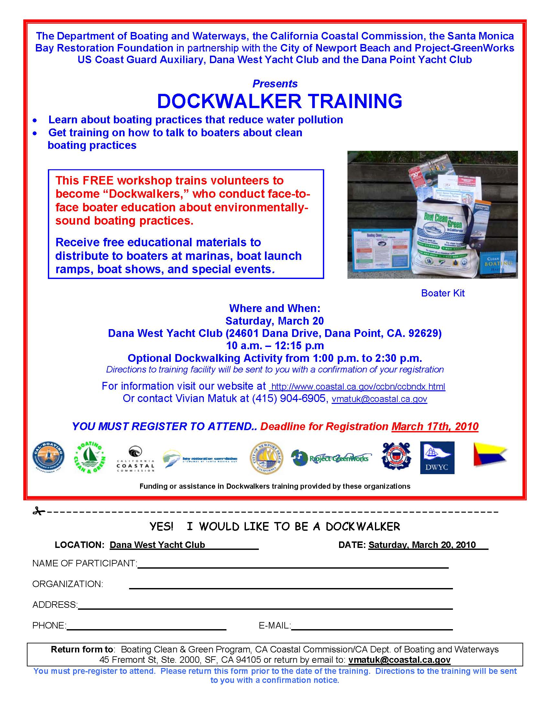
Other Issues: Dockwalker Training
Dana West Yacht Club
Saturday, March 20
Long Beach, Shoreline YC
Saturday, March 27
San Diego, Bay Club Hotel & Marina
Saturday, April 5
Los Angeles, Cabrillo Marine Aquarium
Saturday, May 1

Slide 12
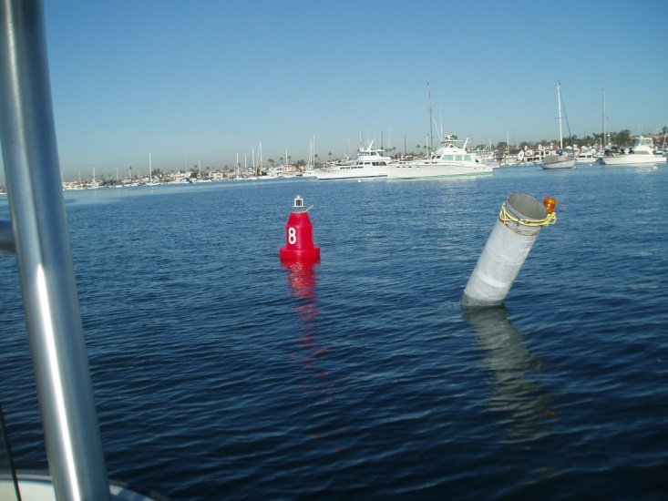
Other Issues
8 Marker (near BYC mooring area)
Steel pile has been hit, creating a hazard
Responsibility of the Coast Guard
Coast Guard issued a “notice to mariners” for 30 days.
Issue was vetted with the harbor community at the January Yachtsman’s luncheon. A red floating buoy is preferred to a pile.
Carter Ford has been instrumental in helping to solve this problem.
Coast Guard may easily solve problem because the pile removal costs are under $5,000.
Coast Guard “Ship Shore Maintenance Record” has been submitted by the Coast Guard for removal.

Slide 13
Other Issues
Mooring administration RFP
Still under consideration by Harbor Resources
Public Dock Extension Project
15th, 19th and Fernando St.
Bid packages will go out soon. Short turn around.
Award contract ~March 9th Council meeting.
Pull permits and begin work by ~April.
Water Taxi
Council considered the item February 9.
Authorized the City to test market demand by incorporating the need in an upcoming questionnaire
Did not authorize Summer 2010 program

Slide 14
Other Issues
OC Natural History Lecture
Hosted by Harbor Resources – Marine Education and Protection – Back Bay Science Center, 7-9 PM
March 3 – Mammals in the Ocean
April 7 – Sky Above Southern California
May 5 – Rescuing Wild Animals
June 2 – Native American Uses of Local Plants
Harbor Patrol Bulkhead Project
Where will the dredged material go?
2,000 cy of sandy material
Agencies have deemed it “unsuitable” for beach disposal
County will dispose elsewhere (landfill, cover etc…)

Slide 15
Harbor Commission Vacancies
Appointed Re-Appointed Term Expires
Tim Collins 4/9/02 6/27/06 6/30/10
John Corrough 4/9/02 6/27/06 6/30/10
Karen Rhyne* 6/27/06 6/30/10
Harbor Commissioners may run two full 4-year terms.
* Commissioner Rhyne may be reappointed again.

Slide 16
Next Meeting
Wednesday, March 10
6:00 pm
Suggested Meeting Dates for April
April 7th
(Fire Conference Room)
or
April 21st
(Council Chambers)

Slide 17
For More Information
http://www.newportbeachca.gov/HarborResources
Chris Miller, Harbor Resources Manager
cmiller@newportbeachca.gov
(949) 644-3043
Shannon Levin, Harbor Resources Supervisor
shannon@newportbeachca.gov
(949) 644-3041

